Slide 1


Slide 2
Cryptarithmetic 1.2

Slide 3
Introduction
Cryptarithmetic problems are where numbers are replaced with alphabets. By using standard arithmetic rules we need to decipher the alphabet.

Slide 4
General Rules:
1. Each alphabet takes only one number from 0 to 9 uniquely.
2. Two single-digit numbers sum can be a maximum 19 with carryover. So carry over in problems of two number addition is always 1.
3. Try to solve the left-most digit in the given problem.
4. If a × b = kb, then the following are the possibilities (3 × 5 = 15; 7 × 5 = 35; 9 × 5 = 45) or (2 × 6 = 12; 4 × 6 = 24; 8 × 6 = 48)

Slide 5
Question 1:
Find the sum of the values of A, B and C if ABC=A!+B!+C! where ABC is a three digit number
a)7
b)8
c)9
d)10

Slide 6
Notes:
Explanation:
By symmetry, we take A is the maximum number of the three alphabets.
Let us say A can take a maximum value of 6. Then 6! = 720 but we have taken maximum value is A is 6.
Therefore, the Maximum value of the digits is less than 6. So A should take 5. Then 5! = 120
Now from the above, we know that one the B and C should take 1 as their value as 120 consists of 1.
⇒ 5! + 1! = 121 If we take 4 as one of the number then 5!+ 1! + 4! = 145 or 1! + 4! + 5! = 145
Sum = 1 + 4 + 5 = 10

Slide 7
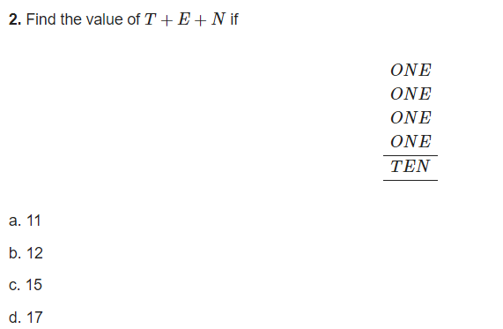
Question 2:

Slide 8
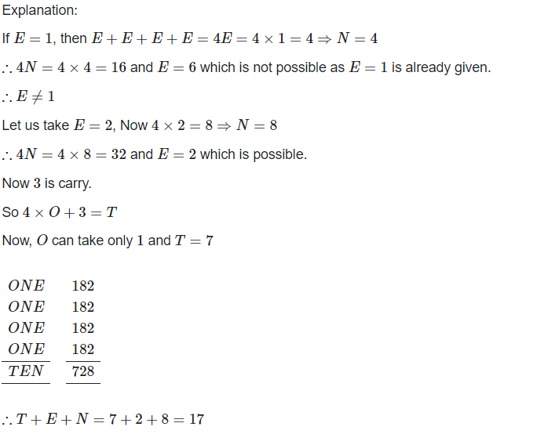
Notes:

Slide 9
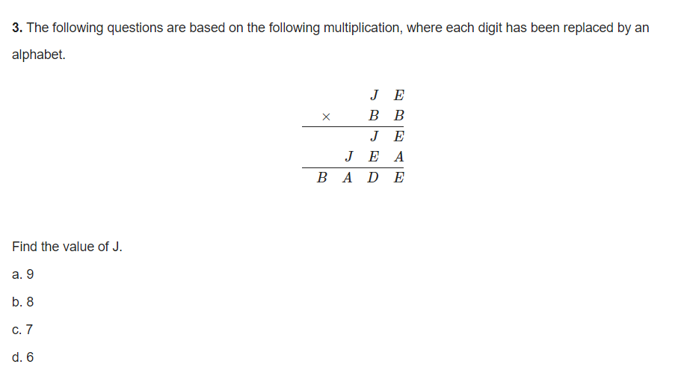
Question 3:

Slide 10
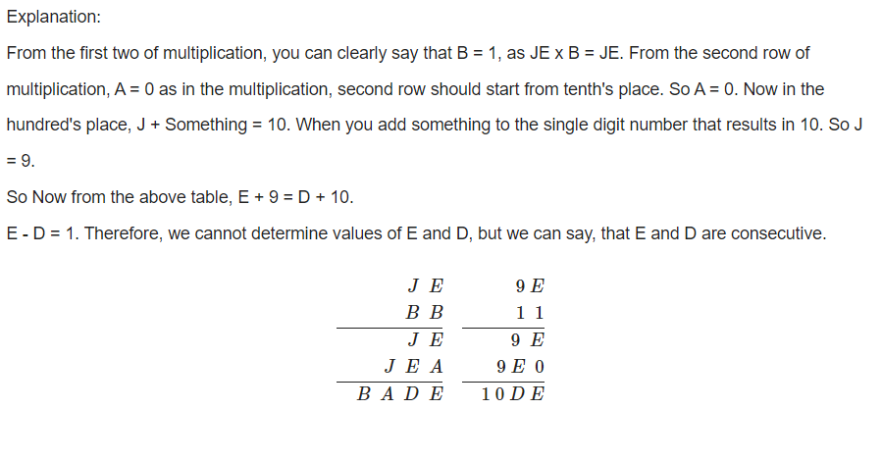
Notes:

Slide 11
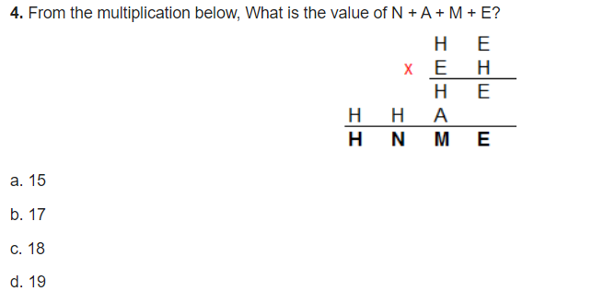
Question 4:

Slide 12
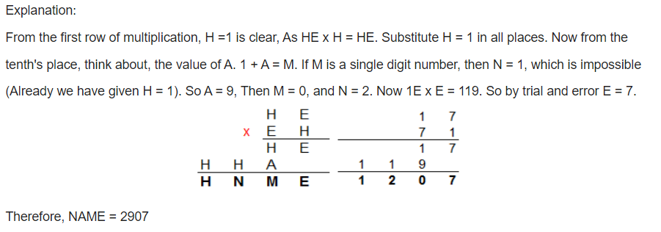
Notes:

Slide 13
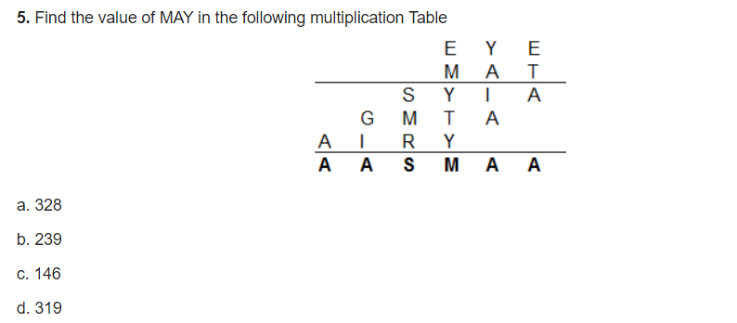
Question 5:

Slide 14
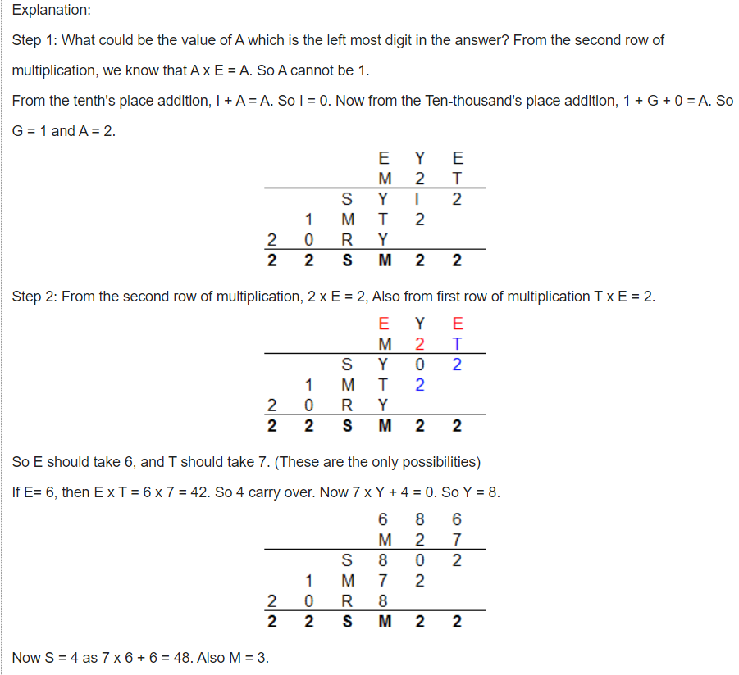
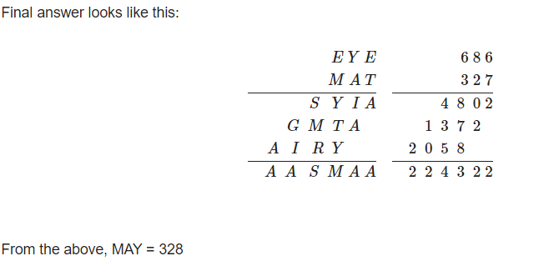
Notes:

Slide 15
Question 6:
If AA + BB = ABC, then what is the value of A+B+C=?
a.15
b.18
c.21
d.12

Slide 16
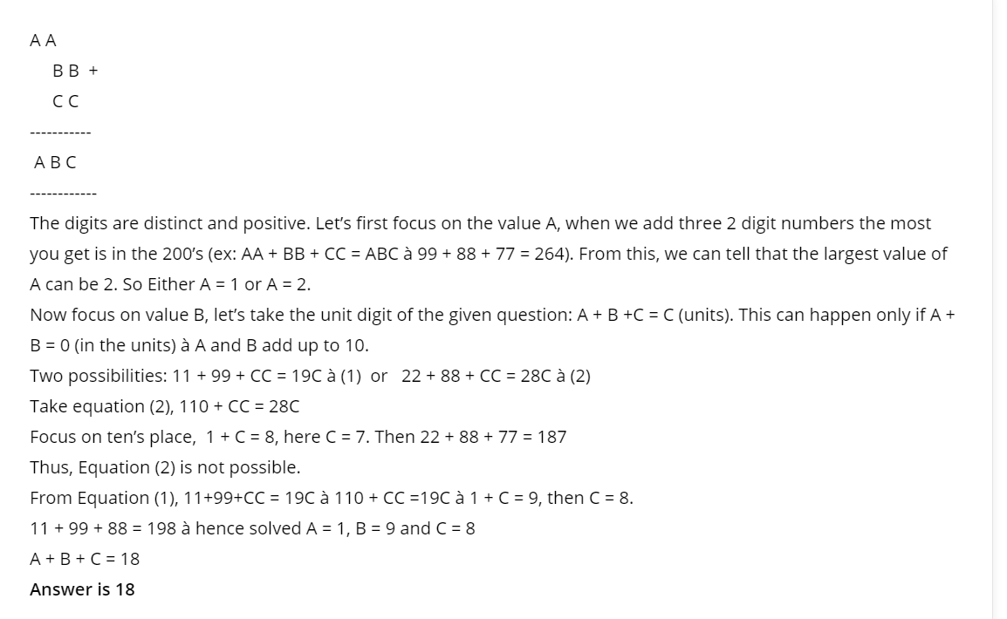
Notes:

Slide 17
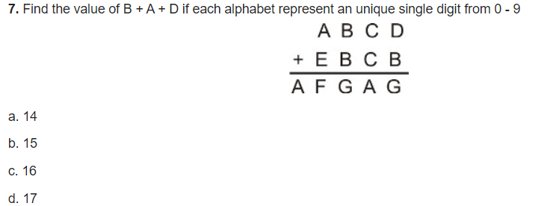
Question 7:

Slide 18
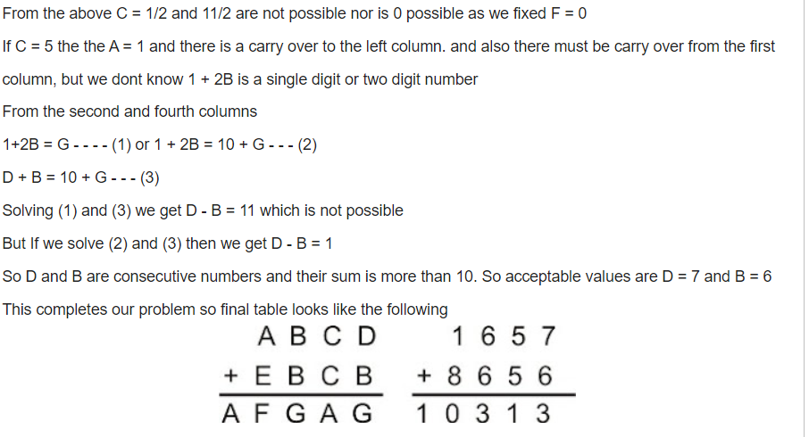
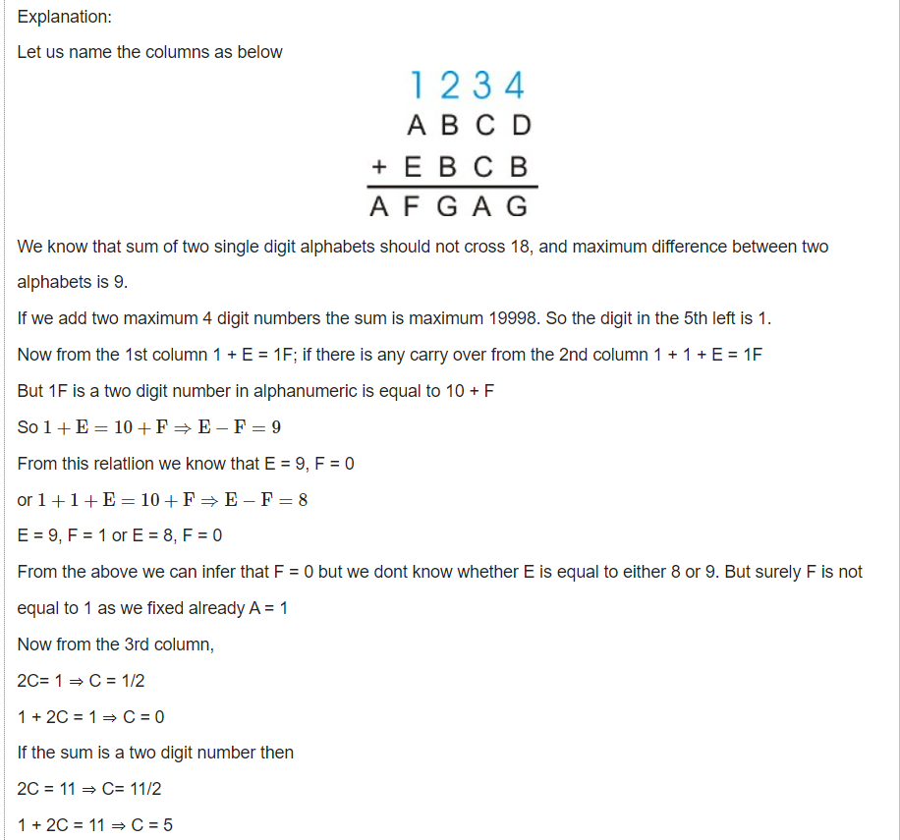

Slide 19
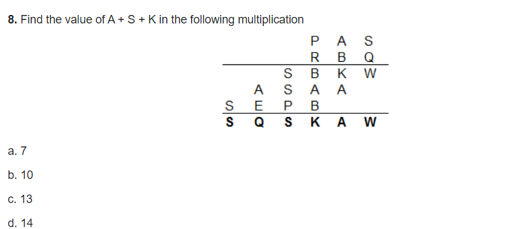
Question 8:

Slide 20
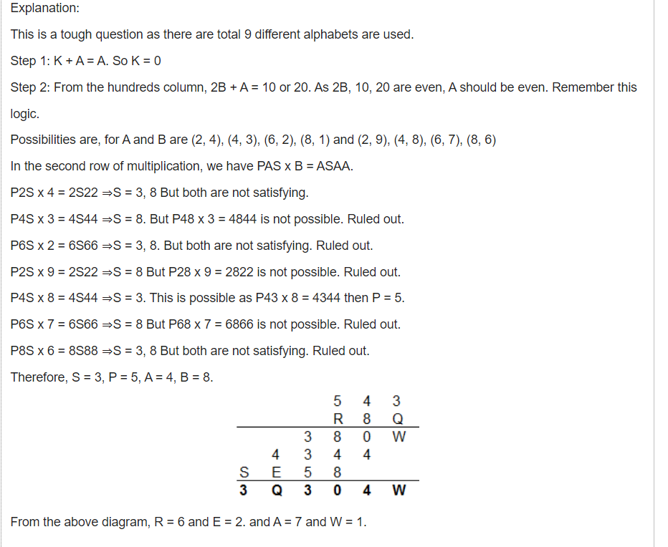
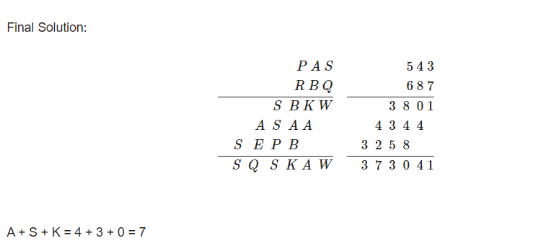

Slide 21
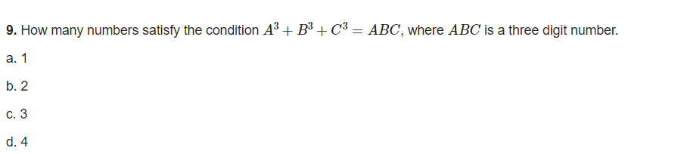
Question 9:

Slide 22
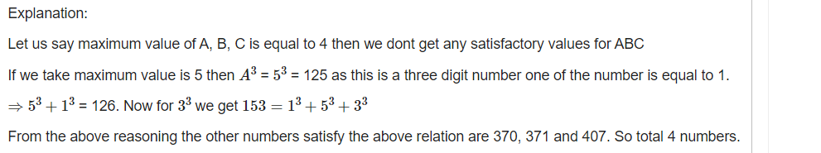
Notes:

Slide 23
Question 10:
N O + G U N + N O = H U N T, find the value of HUNT.
a)1082
b)1802
c)1208
d)1280

Slide 24
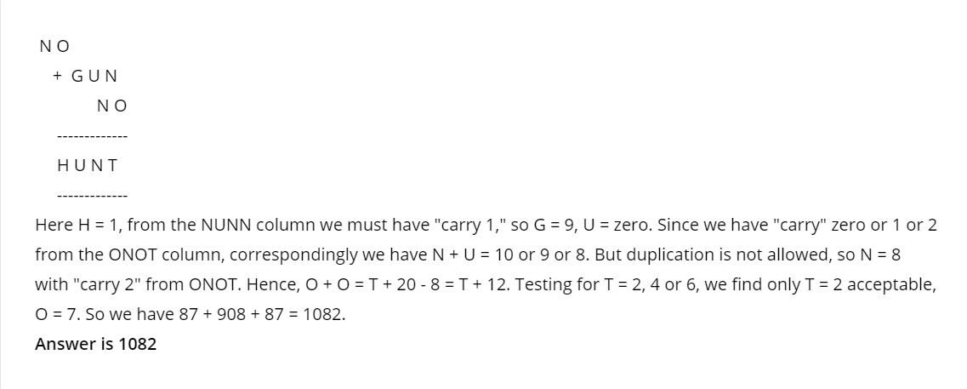
Notes:

Slide 25
Exercise 1:
MAC + MAAR = JOCKO, find the value of 3A + 2M + 2C.
Notes:
ANS:31

Slide 26
Exercise 2:
FORTY + TEN + TEN = SIXTY, find the value of T+E+N?
Notes:
ANS:22

Slide 27

Exercise 3:
Notes:
ANS:17

Slide 28
Exercise 4:
LEMON + ORANGE = FRUIT, Check whether the equation is correct or not.
Notes:
ANS:correct

Slide 29
Exercise 5:
APPLE + BANANA = CHERRY, Check whether the equation is correct or not.
Notes:
ANS:correct

Slide 30
THANK YOU

